Slide 1



Insights for Marketing Strategy - Food & Beverage Industry
Mohd Shadab Alam
07 September 2024

Slide 2



Table of Content
This is the material point that will be delivered in the presentation.
01
02
03
04
Demographic Insights
Consumer Preference
Competition
Brand Perception
05
06
Purchase Analysis
Contact Us

Slide 3


Introduction
The food and beverage industry is highly dynamic, influenced by shifting consumer preferences, competition, and evolving market trends. This presentation provides insights into key areas such as demographic breakdowns, consumer preferences, competition, brand perception, and purchasing behavior.

Slide 4
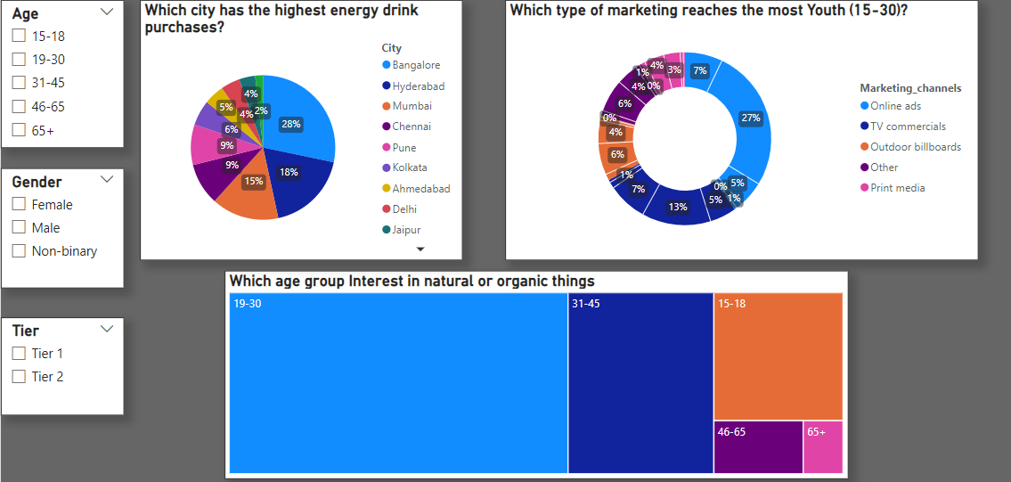
Key Demographics
Which city has the highest energy drink purchases?
Which type of marketing reaches the most Youth (15-30)?
Which age group Interest in natural or organic things

Slide 5
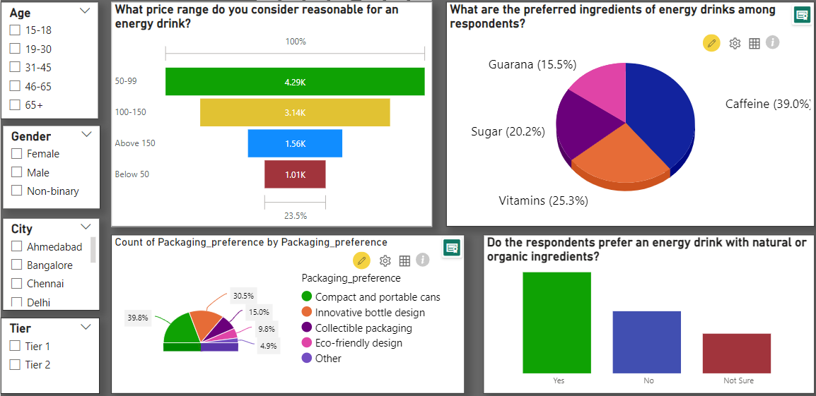
Consumer Preferences
What price range do you consider reasonable for an energy drink?
What are the preferred ingredients of energy drinks among respondents?
What are the preferred ingredients of energy drinks among respondents?
Do the respondents prefer an energy drink with natural or organic ingredients?

Slide 6
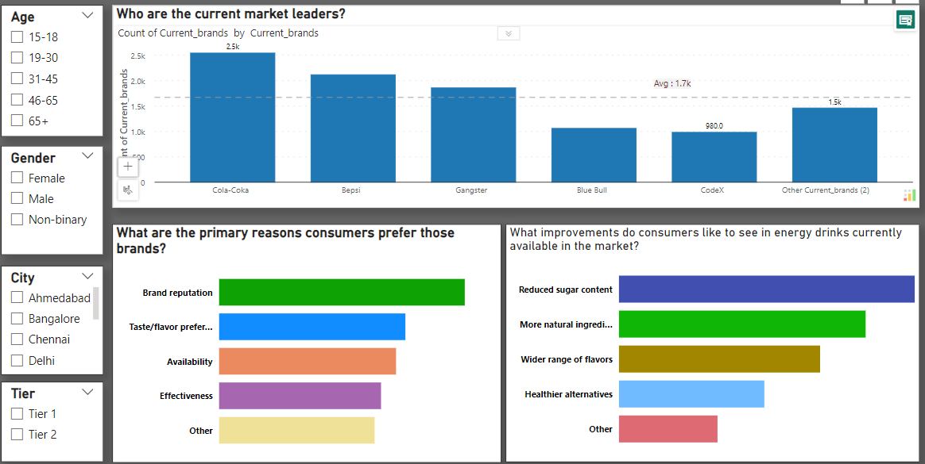
Competition Analysis
-Who are the current market leaders?
-What are the primary reasons consumers prefer those brands?
-What improvements do consumers like to see in energy drinks currently available in the market?

Slide 7
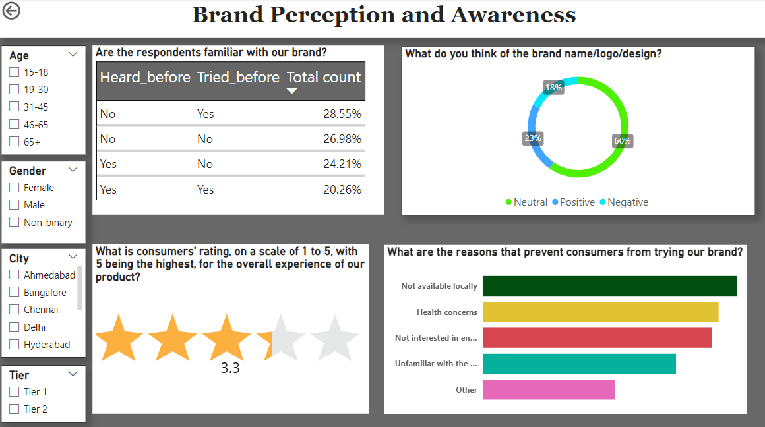
Brand Perception & Awareness
Are the respondents familiar with our brand?
What do you think of the brand name/logo/design?
What is consumers' rating, on a scale of 1 to 5, with 5 being the highest, for the overall experience of our product?
What are the reasons that prevent consumers from trying our brand?

Slide 8
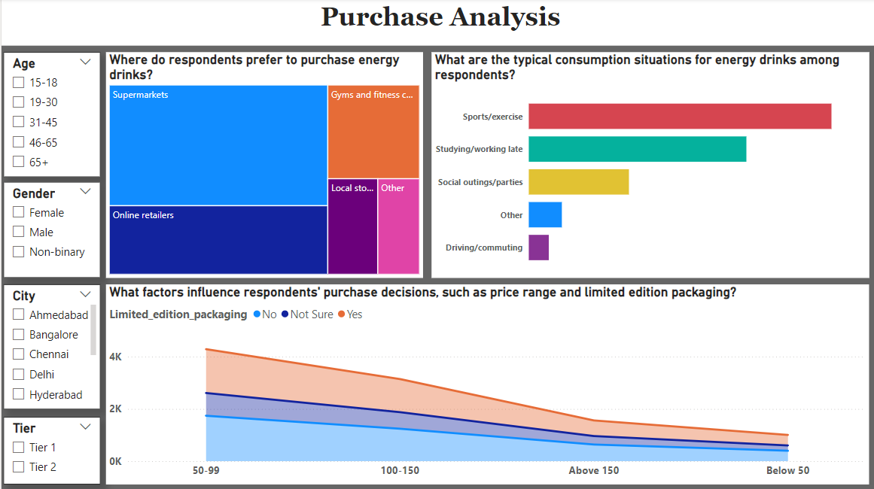
Purchase Behavior Analysis
Where do respondents prefer to purchase energy drinks?
What are the typical consumption situations for energy drinks among respondents?
What factors influence respondents' purchase decisions, such as price range and limited edition packaging?

Slide 9

Thank you

